Slide 1


Welcome
to
St Margaret of Scotland Catholic Primary School
Information Evening for Early Years Foundation Stage Parents September 2021

Slide 2
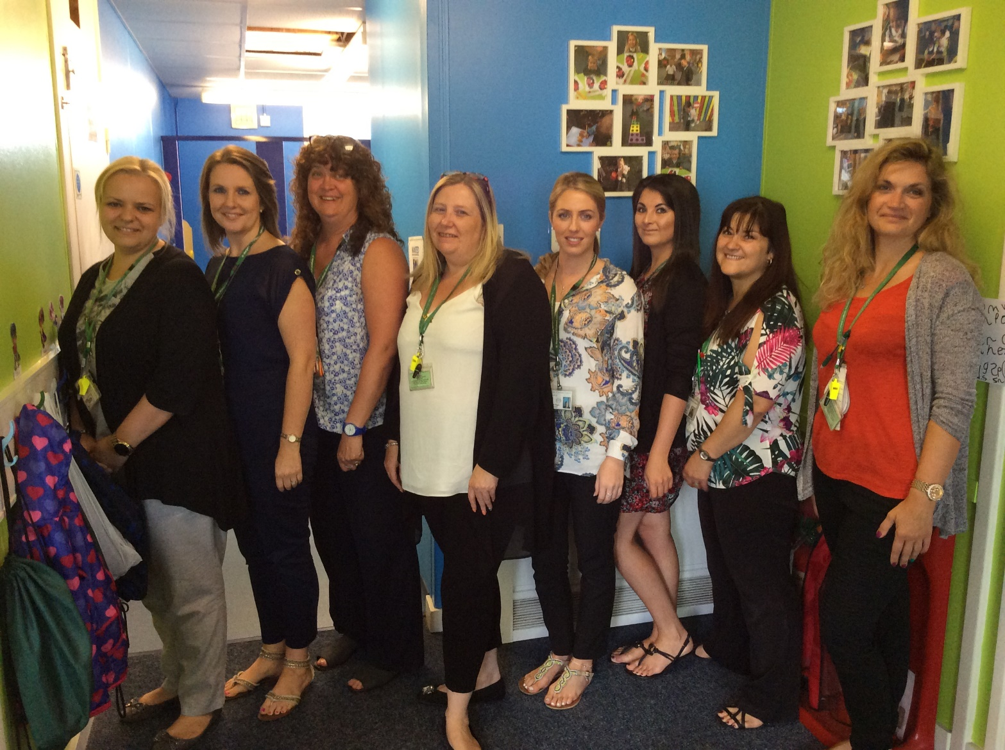
The Early Years Team

Slide 3
The Early Years Team
Miss Rosson
EYFS Lead
EYFS St Bernadette Class Teacher

Slide 4
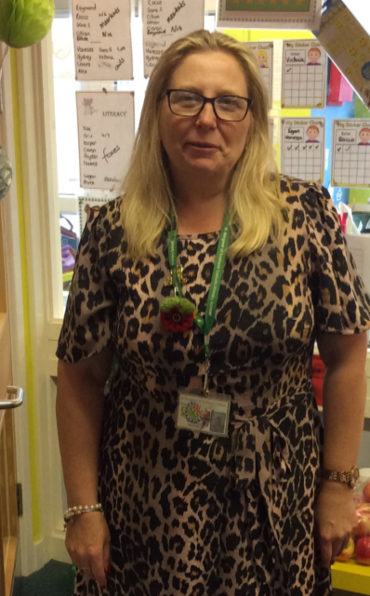
The Early Years Team
Mrs Neal
EYFS St Clare Class Teacher

Slide 5
The Early Years Team
Mrs Durkin
Early Years Assistant

Slide 6
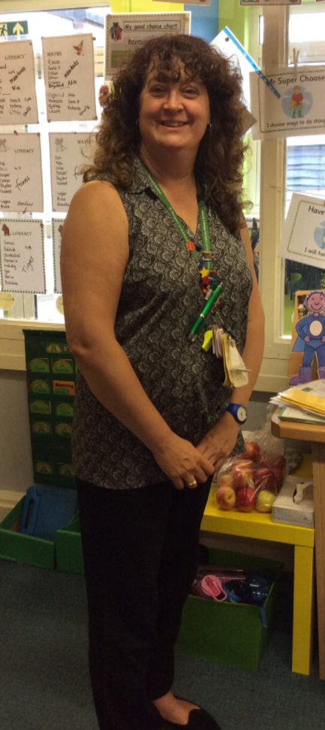
The Early Years Team
Mrs Balducci
Early Years Assistant

Slide 7
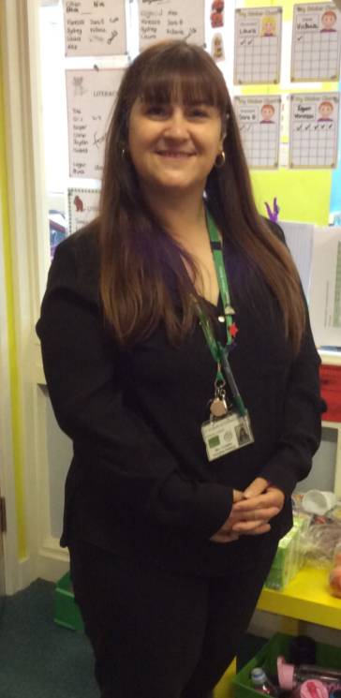
The Early Years Team
Mrs Coakley
Teaching Assistant

Slide 8
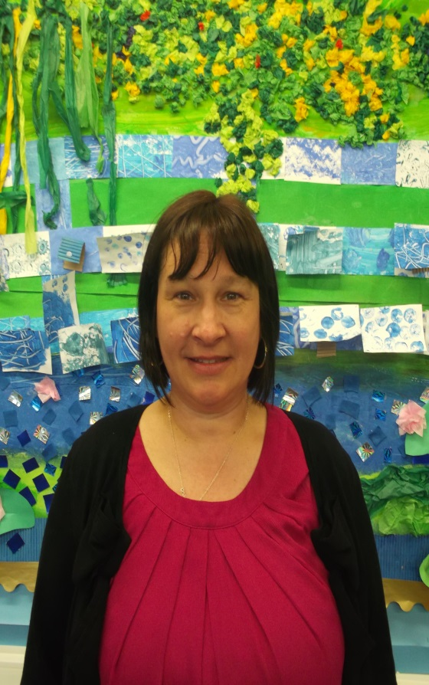
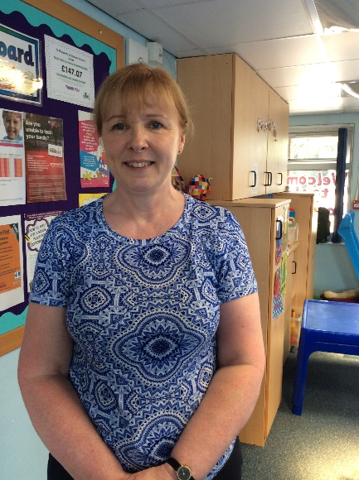
Family Workers
Our role is to assist families in a range of areas including accessing support in the wider community, home learning, behaviour management and supporting general home life.
We also usually run stay and play sessions and parent workshops throughout the year, which we hope to begin again over the next year. We would love for you to join us for these and will send out information once we are able to run these for you again!
Julie Barnaville
Julie Wiles

Slide 9
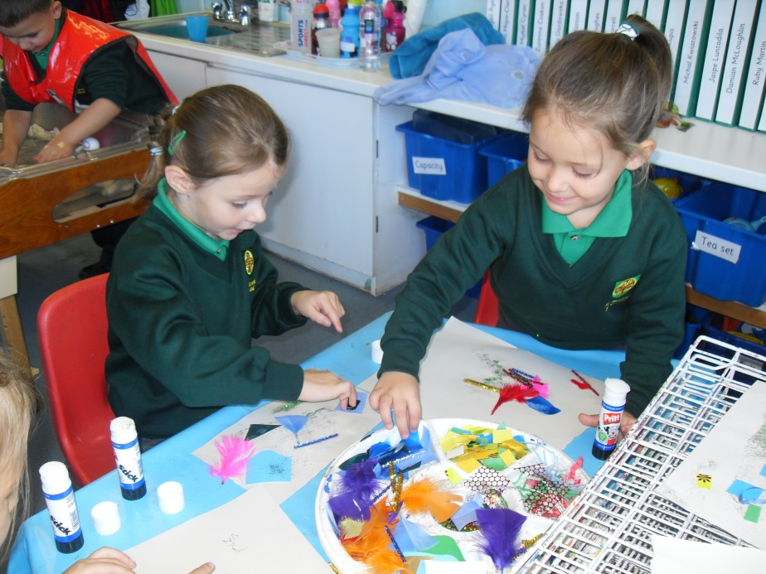
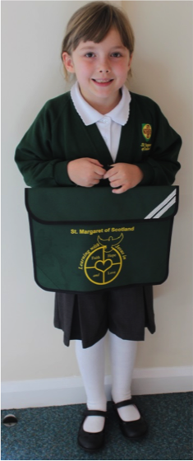
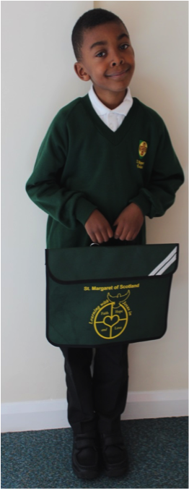
Uniform
White polo shirt
Grey trousers or skirt
Green school jumper with logo
Smart school shoes
Long hair needs to be tied up
Small stud earrings only
School book bag
PE kit
Green shorts
White t-shirt
Plimsolls
Earrings – small studs only. Please remove on PE days for health and safety purposes.
Encourage independence
Notes:
Gabe Book bag PE kit

Slide 10
Uniform
All uniform can be ordered online: https://www.essentialschoolwear.com/
Please help your child to get ready for school by practising to dress and undress themselves as much as possible over the summer. This will really help to encourage their independence and develop their self-care skills.
Notes:
Gabe Book bag PE kit

Slide 11
School Hours
School day - 8:30am–3pm
Morning
Arrive between 8.15am–8:25am to be settled in class by 8:30am
You would usually bring your child to school using the Early Years entrance (across the KS1 playground as seen on the virtual tour), however this may change due to Covid regulations. We will update you with any changes at your home visit.
School gates shut at 8:25am
After 8:25am enter via reception
Punctuality and attendance – please come into school everyday and arrive on time.
Lunch – 11:30am-12:30pm. All children in Early Years are entitled to receive a free school meal. If you would like your child to have a packed lunch, please speak to your child’s class teacher.
Afternoon
Pick up at 3pm from EYFS classrooms (Any changes we will confirm on home visits).

Slide 12
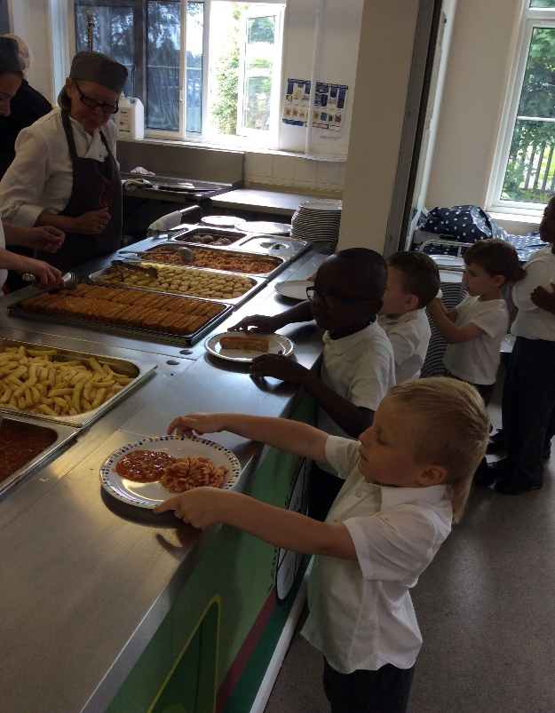
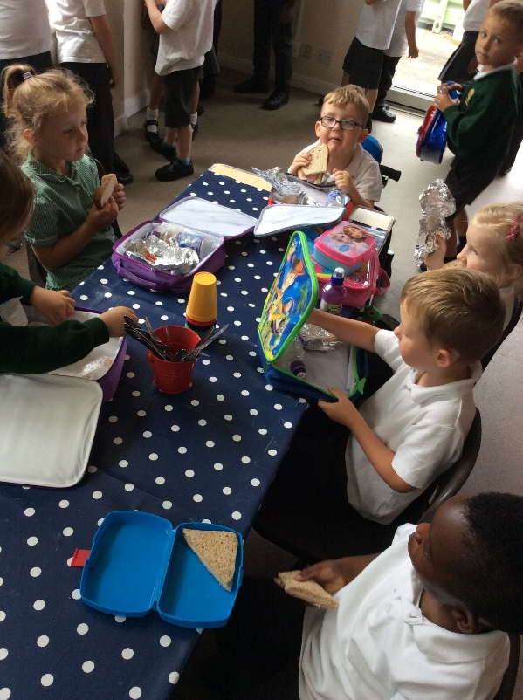
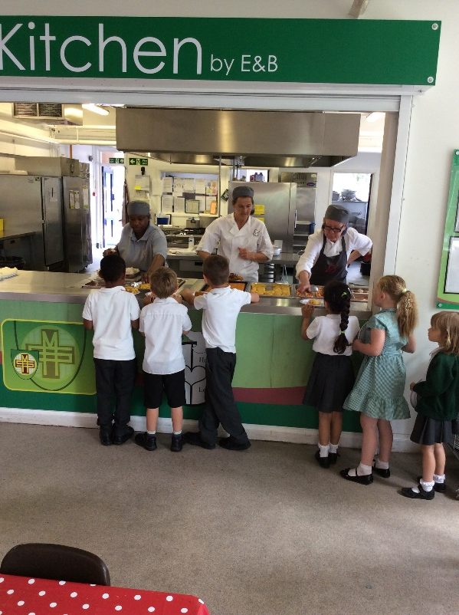
Lunch Time
Lunch – 11:30-12:30
Packed lunch or free school dinner
An example menu can be found on the next slide or on our school website by following this link: https://www.stmargarets.luton.sch.uk/wp-content/uploads/2021/04/St-Margaret-March_April-2021-Menu-FINAL.pdf

Slide 13
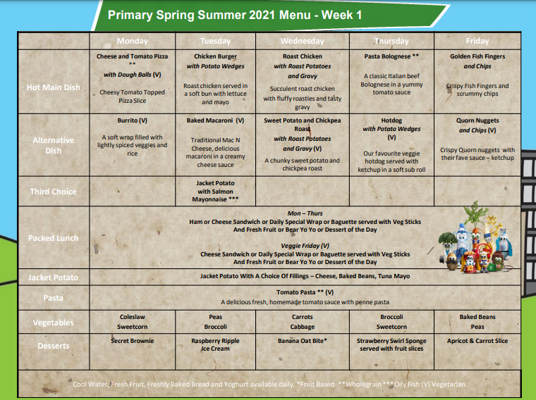

Slide 14
A day at St Margaret’s...

Slide 15
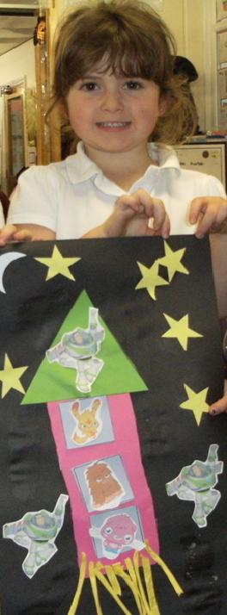
Our Curriculum
7 areas of learning in our curriculum.
Play-based learning opportunities.
We believe it is extremely important to have the children’s key interests and fascinations at the heart of their learning.
This excites and motivates the children to want to learn.

Slide 16
Exploration Time
We have very beautiful, spacious classrooms in our EYFS unit that provide an excellent learning environment for our children. Each of our classrooms has a focus on different areas of learning, such as construction, malleable or role-play. This encourages all of our children to access a broad range of learning opportunities across the curriculum during their child-initiated learning time, which we call ‘Exploration Time’.
Children will be able to ‘free-flow’ between classes to enable them to access a range of learning opportunities, as well as make friendships with children across the year group.

Slide 17
Exploration Time
We also have a fantastic outdoor environment, where the children are able to continue their learning across the curriculum on a larger, louder and messier scale! The children have access to the outdoor classroom throughout the day, during ‘Exploration Time’ and often choose to continue their learning outside. We encourage the children to explore the outdoor area in all weathers, as long as they have the suitable clothing, such as rain macs and welly boots!
The children love to explore and investigate the natural environment and this not only supports the learning from inside the classroom, but also contributes to a healthy life-style, allows the children to experience nature, develop confidence, self-esteem and vocabulary skills and supports their development of the characteristics of effective learning, such as through collaborative work, problem-solving or risk-taking.

Slide 18
Parliament Time
We hold our children’s interests and enjoyment at the centre of their learning. To help them to take ownership of their learning, we hold weekly ‘planning meetings’ with the children, called ‘Parliament Time’.
During this time, children will be encouraged to share their interests, talk about things that they would like to learn and how they would like to do it. We then incorporate these opportunities and ideas into our planning and classroom environments.

Slide 19
Reforms to the Early Years Foundation Stage Framework
The Early Years Foundation Stage (EYFS) has been reformed and there is a new EYFS framework that all schools and settings will have to follow from September 2021. These national changes have been made to better support all young children’s learning and development and better prepare them for the transition into key stage 1.
Below are some of the key points from the new EYFS reforms that include relevant changes which parents, carers and children may notice or experience.
Reduced the amount of unneeded written recordings and assessment of children by staff.
This means staff do not need to keep a large amount of written evidence that proves children are able to do lots of things. Staff still know the abilities and skills of each child, and know how to support them to develop. However, now they do not need to write this down unnecessarily.
This frees up more time for staff to spend directly with the children and focus on high-quality interactions to support the children’s learning. By taking away the need for constant recording, it helps to develop more natural play, conversations and interaction between adults and children.
This means that your child will have less work recorded in books, however we will be making greater use of our online platform for both you as parents and staff to record ‘Wow’ moments throughout your child’s learning journey in Reception.

Slide 20
Reforms to the Early Years Foundation Stage Framework
2. The Early Learning Goals: Children will no longer be assessed against statements from an age band category. Instead, staff will use their experience and knowledge to monitor if a child’s learning and development is on track for their age.
At the end of the reception year, children are assessed against the 17 Early Learning Goals.
It is important to remember that:
  The ELGs are not a test. Staff will use what they already know about a child to make their decisions.
  The ELGs are not the EYFS curriculum. They are not used to be taught to, they are just an end point.
Changes have been made to the Early Learning Goals so that they are now clearer, easier to use and understand.
They have also been adapted to better match up with the National Curriculum in Year 1. This will help children to be better prepared for their move to the next key stage.
Exceeding judgements have also been removed. Children are now encouraged and challenged to have a greater depth and understanding of things before moving onto new learning.

Slide 21
Reforms to the Early Years Foundation Stage Framework
3. There is more of an emphasis on the importance of developing vocabulary and communication and language skills.
Children should be supported in building up vocabulary by increasing the amount of words they know and can use. The reforms encourage more conversations between adults and children, but also children and their peers.
Good language skills are the basis for all other learning and social interaction, so this is vital to focus on.
There will now be increased opportunities for conversations, reading of a wide range of books and holding discussions around activities in other areas of learning.
4. There is a focus on how reading stories is important to help children develop in all of Areas of Learning.
Daily reading of stories encourages an enjoyment of reading from a young age.
Lots of other learning opportunities happen when looking at books, for example comparisons of culture or the past.
Listening to stories develops imagination, ideas and language.
Reading is an essential skill and so should be shown to children, as well as practised by them regularly. Children are also encouraged to use story ideas in their play.
We will provide you with lots of ideas on how you can support language and reading development, through parent workshops and open days. We will provide the details of these in September and throughout the year.

Slide 22

Reforms to the Early Years Foundation Stage Framework
5. There is a focus on encouraging healthy choices overall and an understanding of oral health.
Safeguarding and welfare of children remains a priority, with the added mention of teaching children about the importance of good oral health and how to keep teeth clean and healthy.
Focus on helping children to understand which choices to make that will help them to be healthy, for example which foods to eat and why.
Getting into good routines from a young age is important as these often continue into adult life. Your child’s class teacher and the family workers will be happy to support you in establishing healthy routines at home with your child.

Slide 23
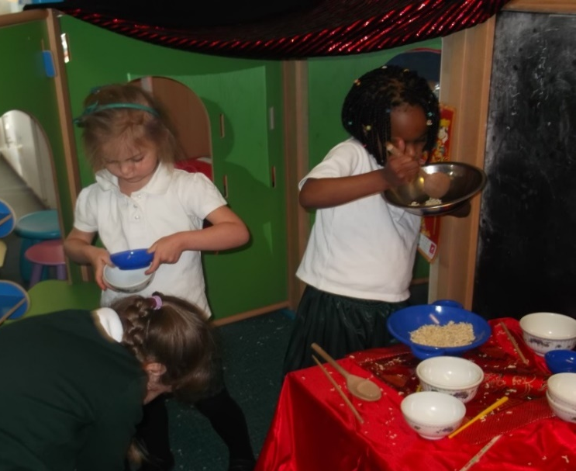
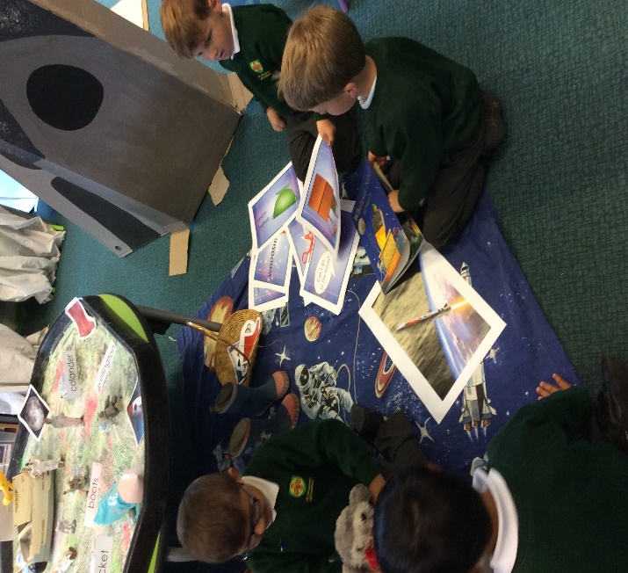
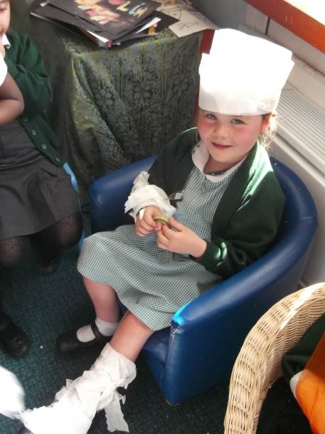
Communication & Language
Early Learning Goals:
Speaking
Listening, Attention and Understanding
Speaking and listening and developing vocabulary are essential parts of our curriculum and are embedded within everything we do.
Reading, re-telling and creating stories
Role play and imaginative play
Discussions and conversations

Slide 24
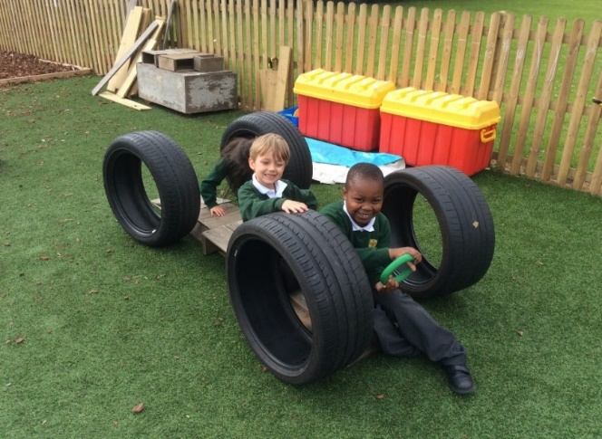
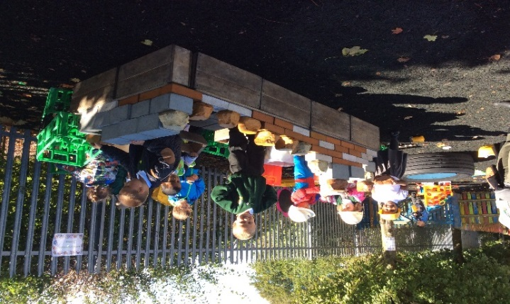
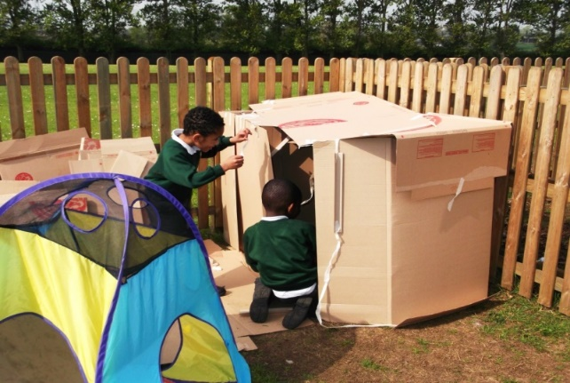
Personal, Social & Emotional Development
Early Learning Goals:
Self-regulation
Managing Self
Building Relationships
Here, the children are developing their social skills by working as part of a team, taking turns and sharing ideas. They are also using appropriate resources to construct in a purposeful way.

Slide 25
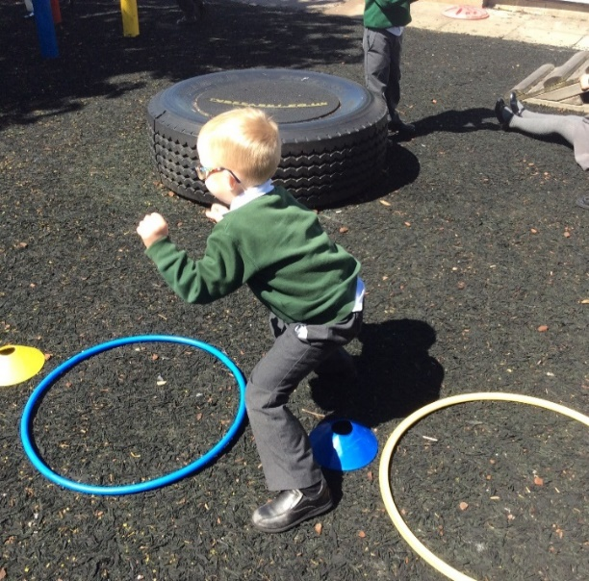
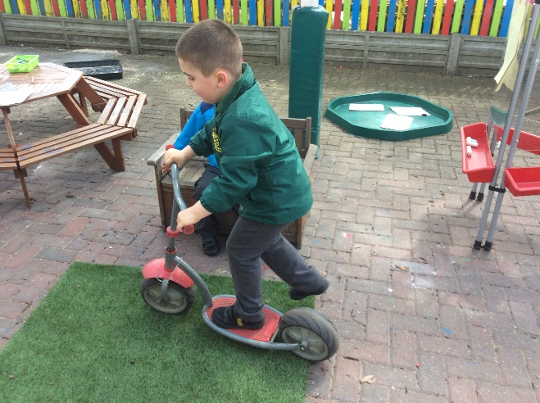
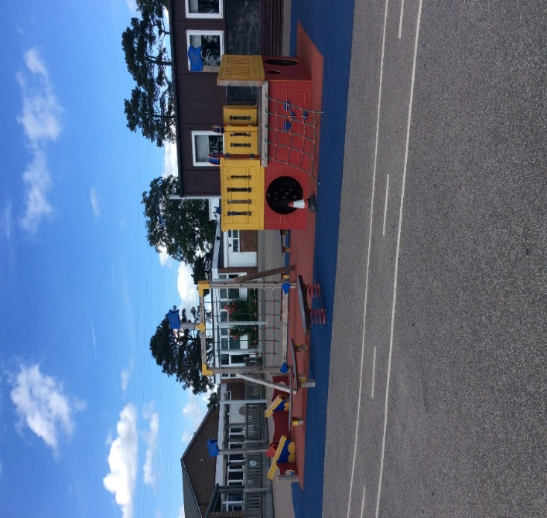
Physical Development
Early Learning Goals:
Gross Motor Skills (large scale movements)
Fine Motor Skills (small scale movements)
Outside activities include; bikes, scooters, football, tennis and skipping
Children are able to access small & large equipment, showing a range of basic skills & coordination
Short PE sessions – due to start after October half term. We will send a letter out to inform you of the days for PE nearer the time.

Slide 26
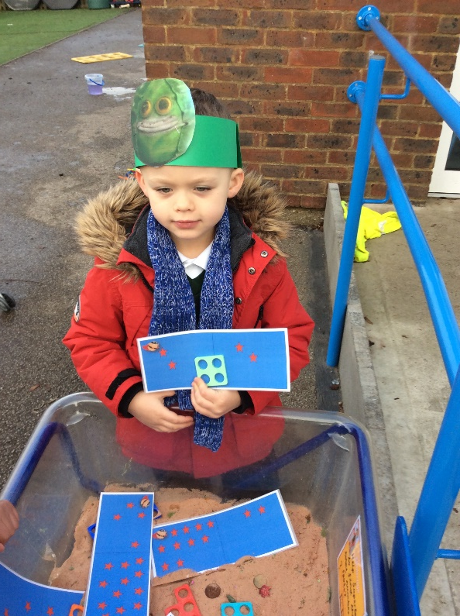
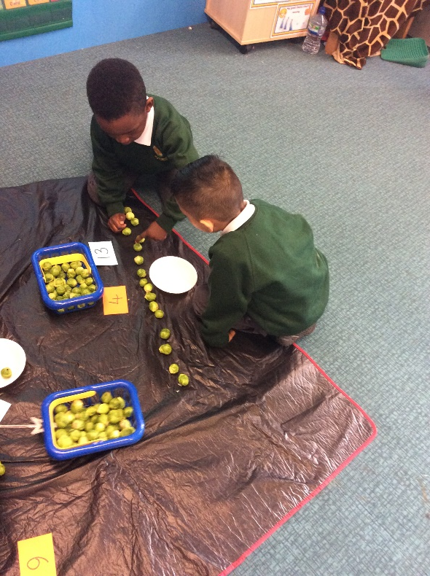
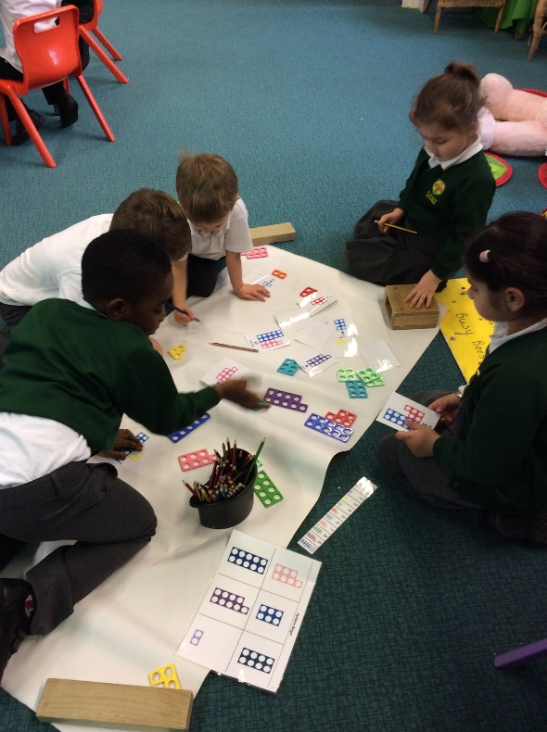
Mathematics
Early Learning Goals:
Number
Numerical Patterns
Children learning to sort, match and count objects. It is important to make maths a fun & practical experience, using objects and games that are of interest to our young children.

Slide 27
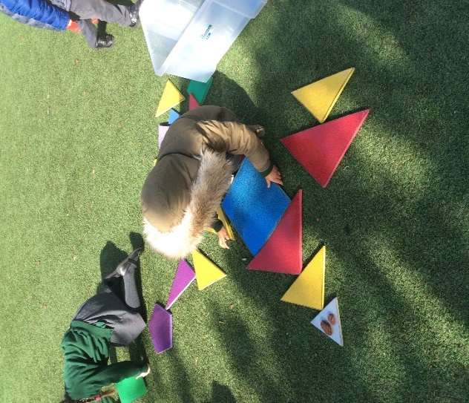
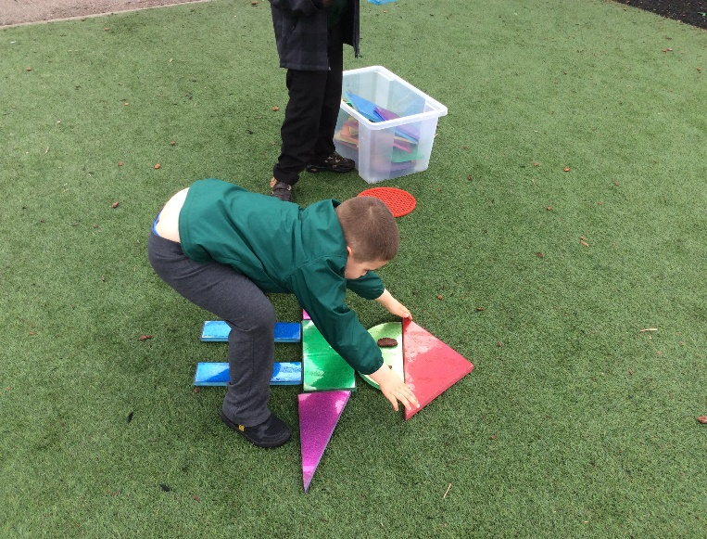
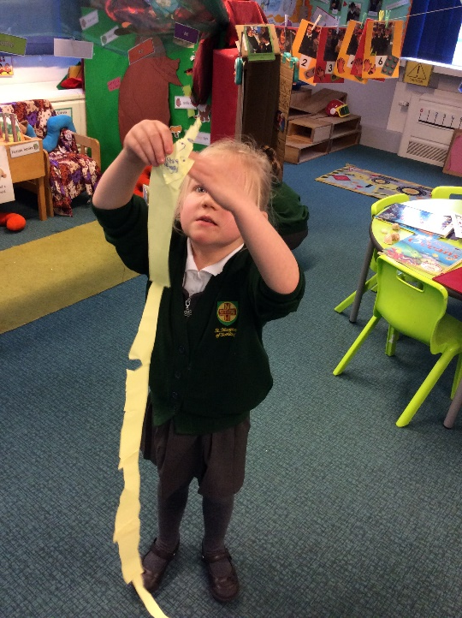
Shape, Space & Measure
While there is no longer an Early Learning Goal for Shape, Space and Measure, our curriculum still incorporates many opportunities for the children to develop an understanding of shapes, length, height, weight, capacity and distance through play. These are a few examples of children gaining an awareness of shape, space and measure.

Slide 28
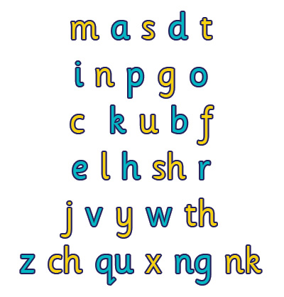

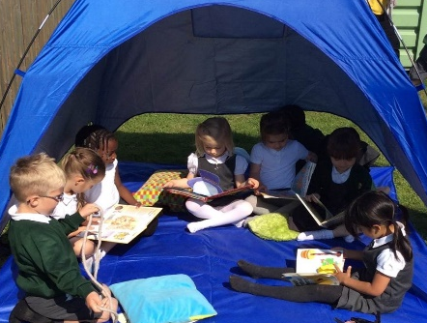
Literacy
Early Learning Goals:
Comprehension
Word Reading
Writing
At St Margaret’s we are passionate about reading and writing and helping all children to develop the skills they need to become successful readers and writers.
We teach the children to read through a
phonics programme call Read Write Inc.
Your support at home is crucial:
  Reading everyday with your child
  Role model – using expression and showing your enjoyment for reading!
RWI parents session – will take place once the children begin school and we would urge you all to attend if possible.

Slide 29
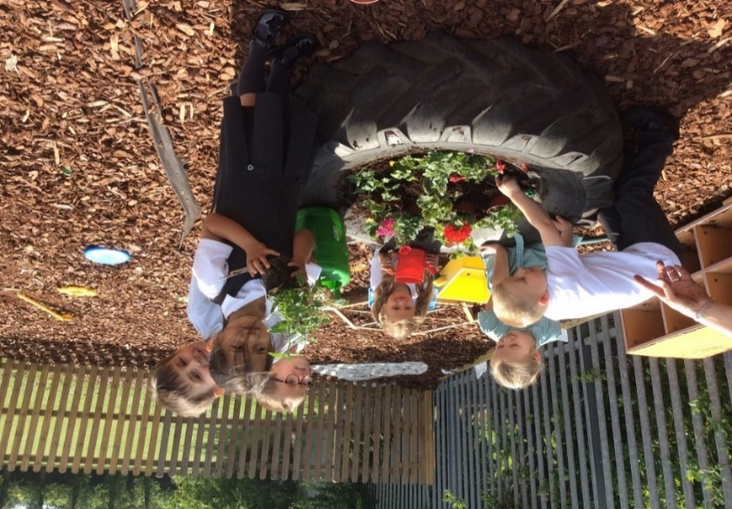
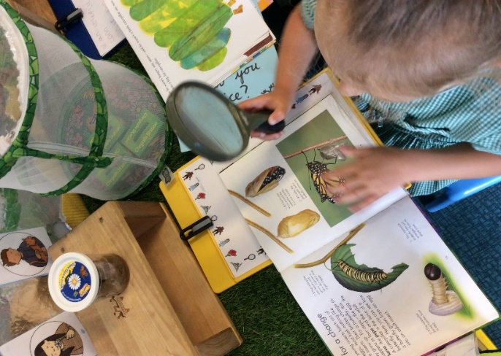
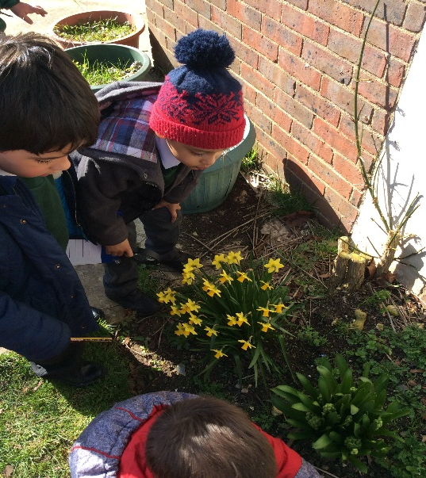
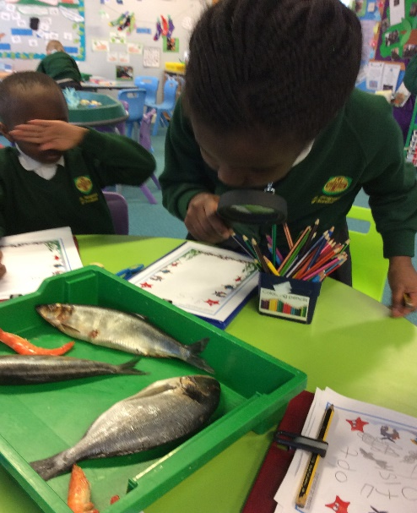
Understanding the World
Early Learning Goals:
Past and Present
People, Cultures and Communities
The Natural World
Teaching children the foundations for learning in science, geography and history.
Outdoor learning broadens and enriches the EYFS curriculum. The outside area is a great place for adventure, investigation and exploratory play.

Slide 30
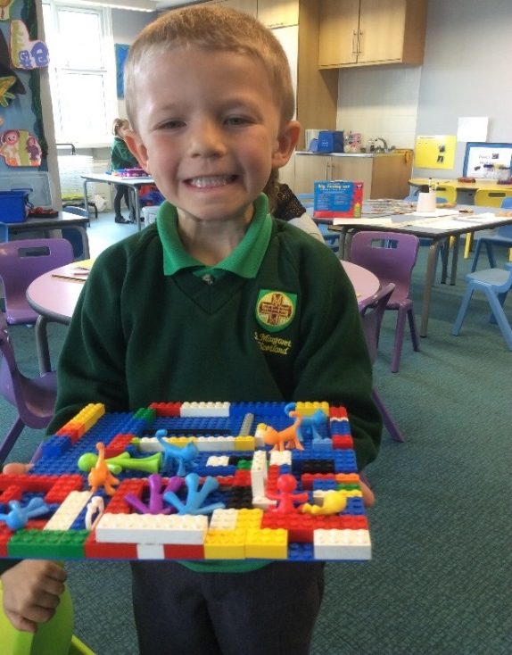
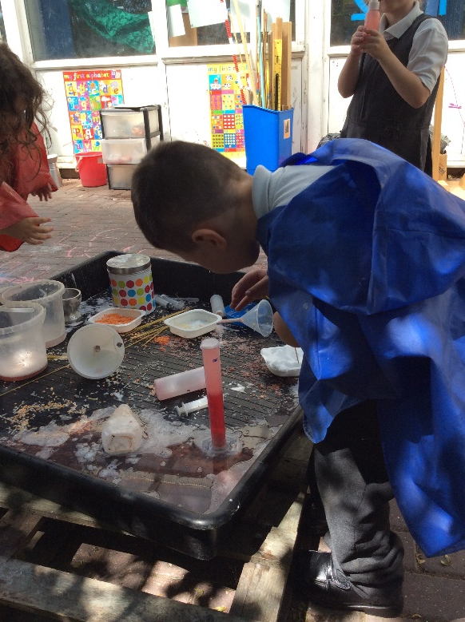
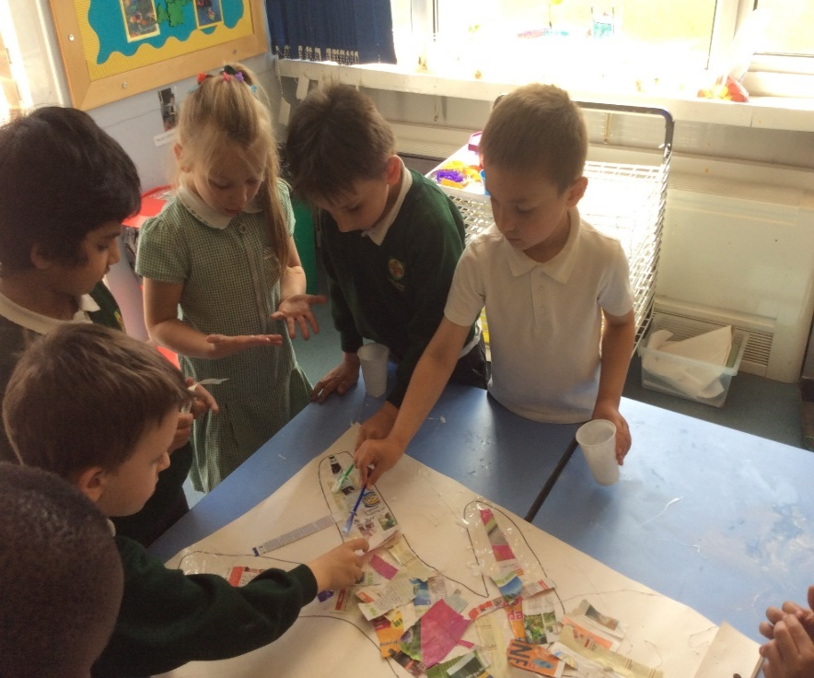
Expressive Art & Design
Early Learning Goals:
Creating with materials
Being Imaginative and Expressive
In Foundation Stage your child will have access to a range of ‘workshops’ and ‘creation stations’. Children learn to explore their creativity using a variety of different media such as; colour, texture, shape, in two and three dimensional forms.

Slide 31
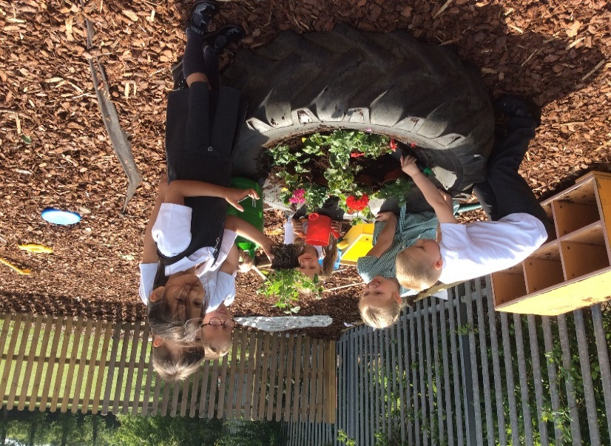
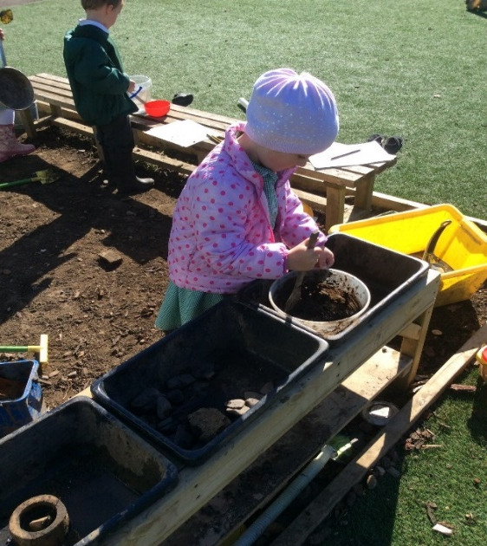
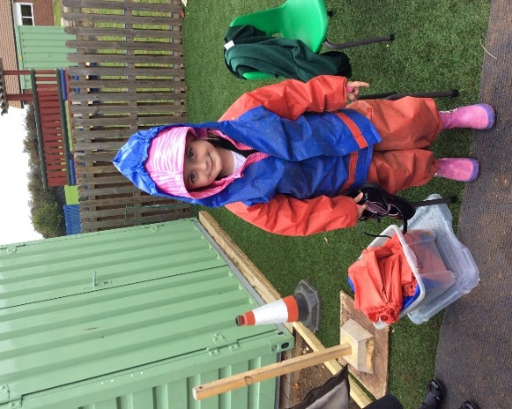
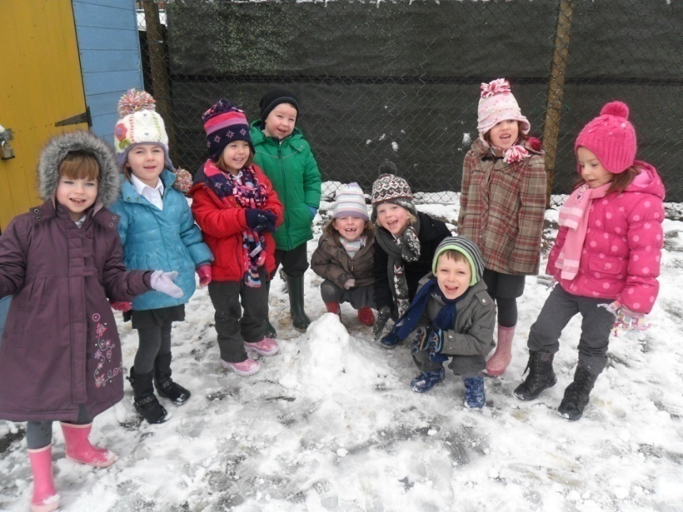
Children in EYFS have access to the outdoor area for the majority of the day and are encouraged to use it in all weathers. Young children learn best in a stimulating environment where they are inspired to discover new things as these examples show.

Slide 32


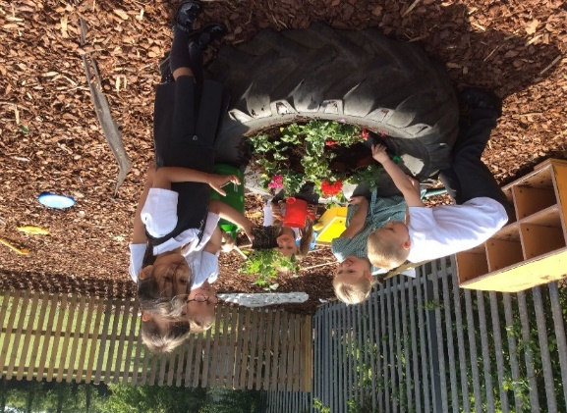
Please ensure that your child has the following appropriate clothing so that they can access their outdoor learning in all weathers:
Warm clothing – coats, hats, scarves, gloves.
Waterproof jackets
Wellington boots – welly rack/sensory kitchen
Sun cream
Sun hats/glasses

Slide 33
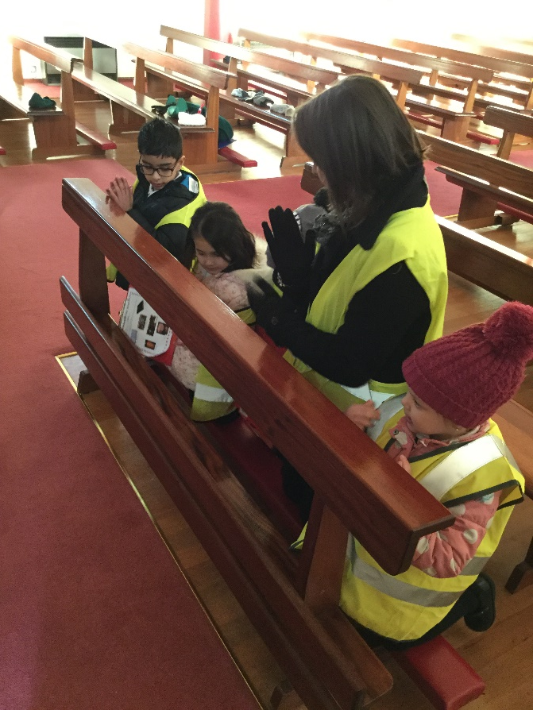
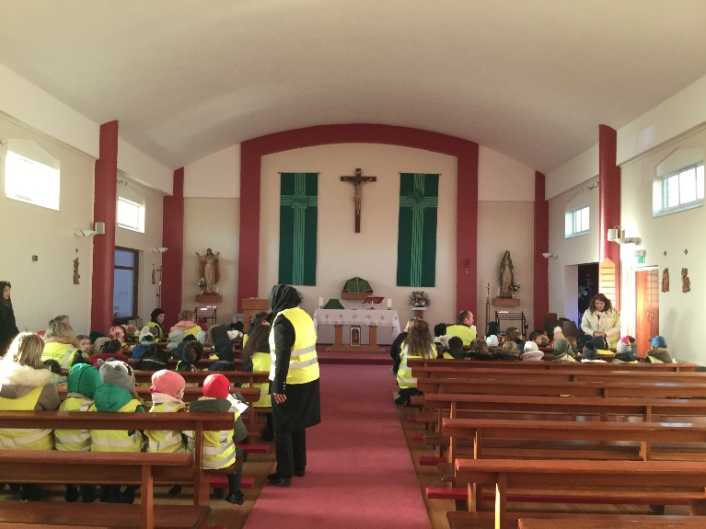
Religious Education
We hold Christ at the centre of our school life.
Prayers and prayer bags – promoting collective worship
between home and school.
Prayer room.
Visits to the church.

Slide 34
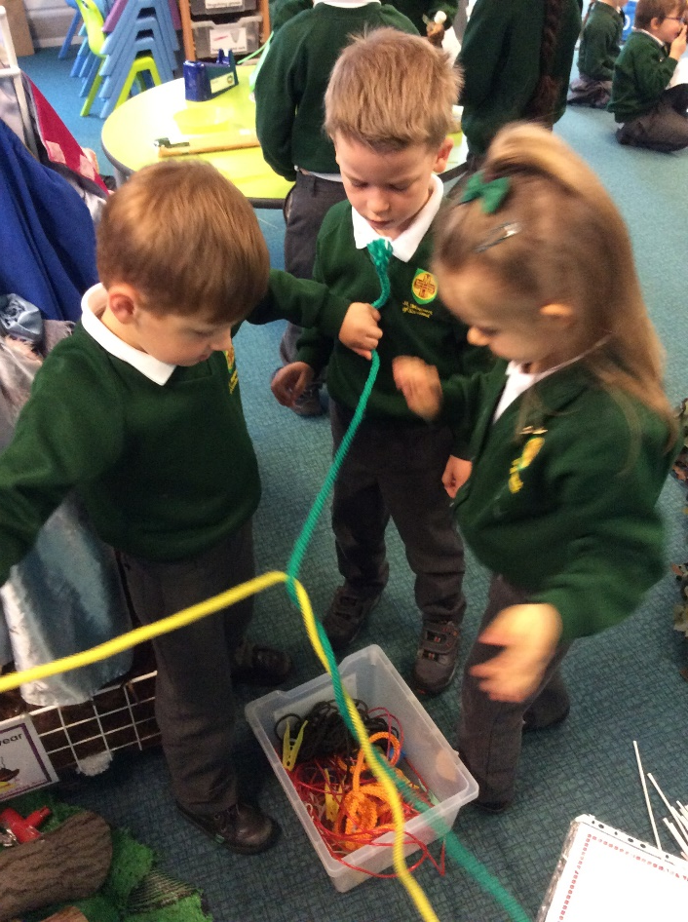
The Characteristics of Effective Learning
The Characteristics of Effective Learning describe how a child learns and how they engage with other people, resources and their environment.
Playing and exploring
Active Learning
Creating and Thinking Critically
The Characteristics of Effective Learning play a central role in your child’s learning and in helping them to become an effective learner.

Slide 35
The Characteristics of Effective Learning
The Characteristics of Effective are interconnected with all areas of learning and underpin all of our practise, planning, teaching and provision.
We reflect upon the different ways in which our children learn and plan and provide opportunities that enable them to develop and display these characteristics to help them to learn and achieve independently.
It is a statutory requirement that we report to you on how your child learns within each of the three characteristics of effective learning.

Slide 36
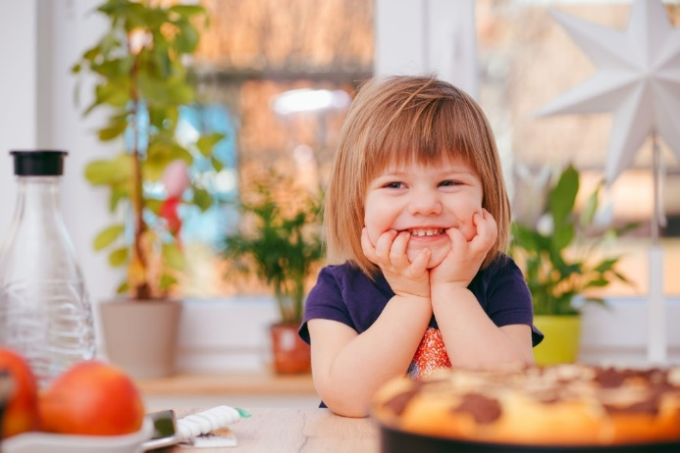
Reception Baseline Assessment
From September 2021, it will be a statutory requirement for all children entering reception year to be assessed within six weeks of starting at their new school. This is known as the Reception Baseline Assessment or RBA.
Children will be assessed in early mathematics, literacy, communication and language through a series of practical contexts and activities. Each assessment will take around 20 minutes to complete, but this does not have to be completed in one sitting.
Data from the RBA will be used to measure progress at a cohort level, by comparing the RBA results to those achieved by the same cohort in end of KS2 assessments. Numerical data from the baseline will be stored in the National Pupil Database (NPD) and will not be shared with external bodies; this includes schools, teachers or parents and carers.

Slide 37
Parental Support
As parents, you play the most vital role in your child’s development in supporting and encouraging your child to reach their full potential. Please help us to work in partnership to provide your child with the best education possible.
Picture books for you to share with your child – reading records.
Parent information sessions and workshops throughout the year – please attend as many as possible for important information and fun ideas on how to support learning at home.
Curriculum Content and Knowledge maps – to inform you of what your child is learning each half term and key vocabulary and concepts that you can help them to learn.
‘Wow’ star slips and parent voice – use of ‘Seesaw’ online platform for sharing children’s achievements between home and school and improving the support we can offer you for continued home learning.

Slide 38
Further Dates
Home visits- Will take place between Thursday 2nd – Tuesday 7th September 2021. Details of what to expect on your home visit have been provided in your welcome pack, along with your appointment time and date. We look forward to meeting you and getting to know you and your child a little better, before their school journey begins!
Intake- When the children begin school, their start dates will be staggered according to the term they were born or individual needs. This is to ensure that your child’s transition into school is a smooth and happy one! The date that your child is due to start school will be placed within the pack. By the 20th September 2020, all children will have entered the setting & will remain full time
Stay & Play sessions – due to current restrictions, our planned Stay and Play sessions will not be able to take place before the Summer. However, we have planned some sessions for September, to help your child to become familiar with their new school environment, their teachers and friends before they become full time. These sessions will take place between Wednesday 8th – Friday 10th September, once all home visits have been completed. Your child will have the opportunity to attend school for a half day session on each of these days, until they begin full time. Please see your pack for more information.

Slide 39

Further Dates
Although we did have some wonderful transition events planned to support you and your child before their start at school, we have unfortunately had to postpone these due to the ongoing Government restrictions. However, we hope to be able to hold some of these in September, once the children have settled into school. This will give you the opportunity for you to find out more about what your child’s first year at school will look like, as well as giving us an opportunity to welcome you into our St Margaret’s family!
In September, we will also be sending out further dates for important parent workshops and open days, such as the Read Write Inc Workshop. Please attend these if possible as they will be really useful in supporting your child’s development and learning.

Slide 40
Class Families
St Bernadette – Miss Rosson
St Clare – Mrs Neal
We look forward to working with you and the children next year!

